Slide 1
TN Police Hackathon
SpamShield
Vishwa Kumaresh - Shiv Nadar University Chennai

Slide 2

Introduction
Spam messages are a growing problem that affects millions of people worldwide. They not only cause frustration and lost productivity, but can also lead to financial loss and even pose a threat and jeopardize personal safety. The spam detection app project aims to address this problem by providing an innovative solution that can detect spam messages in two ways - by detecting incoming messages and by reading messages from the notification space of the user's phone.

Slide 3
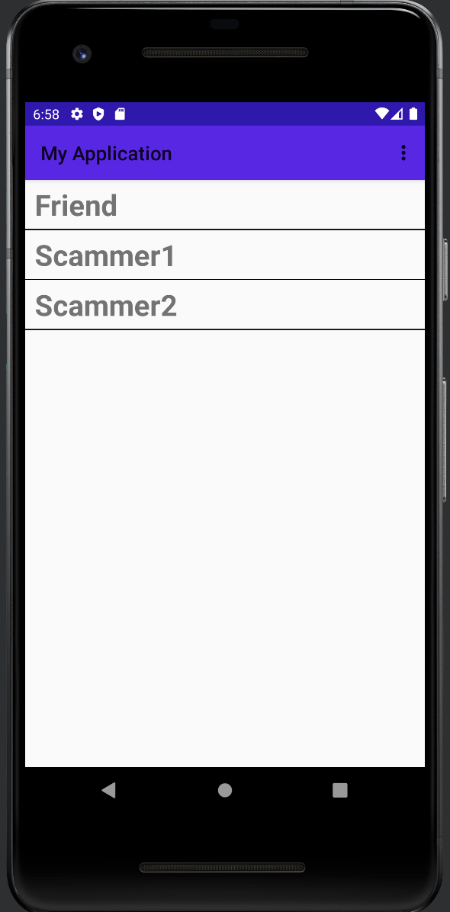
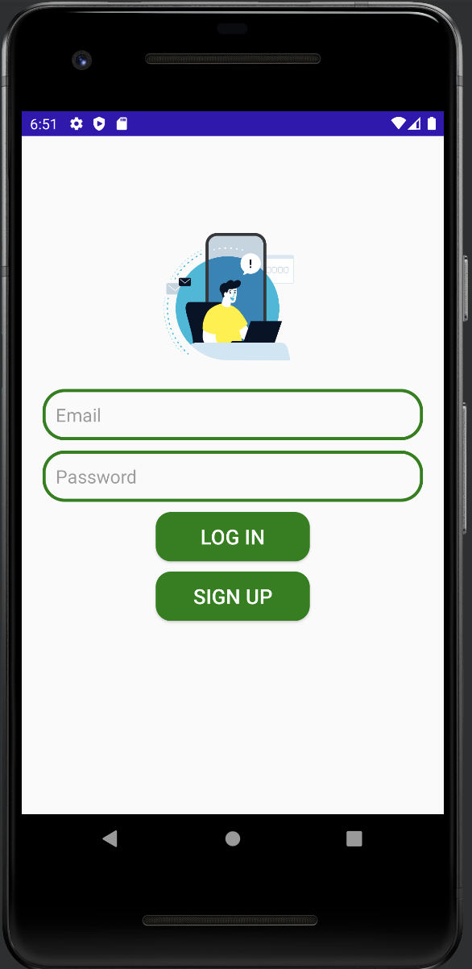
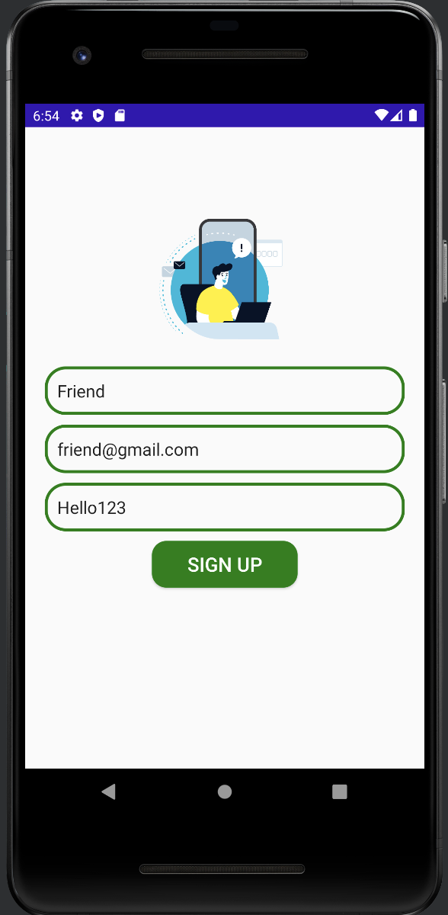
App Demo – UI Design

Slide 4
Architecture used : MVP
Why? : It is easier for people to recognize and use the app, and also allows for others to use my app scalably

Slide 5
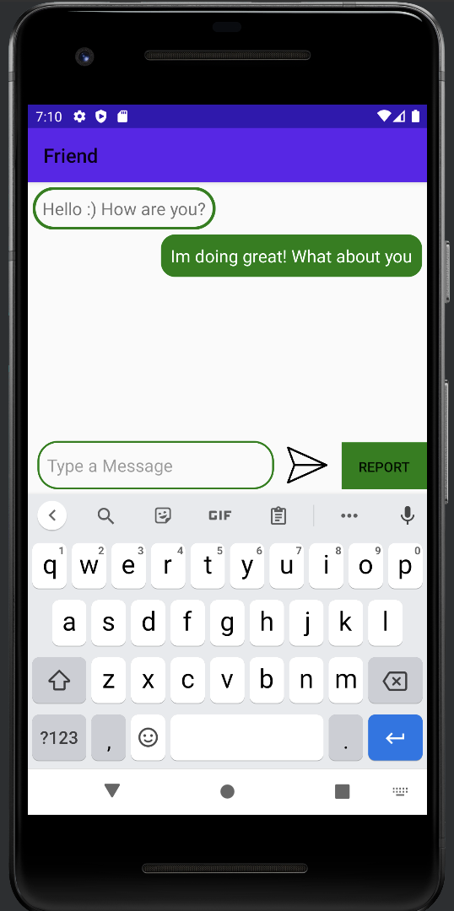
Regular Chat

Slide 6
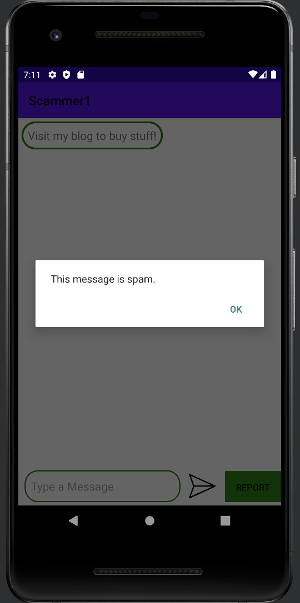
Spam Classification

Slide 7
Why Local Deployment
WHY? : People might not have access to the internet at all times and hence may need to use the local model instead

Slide 8
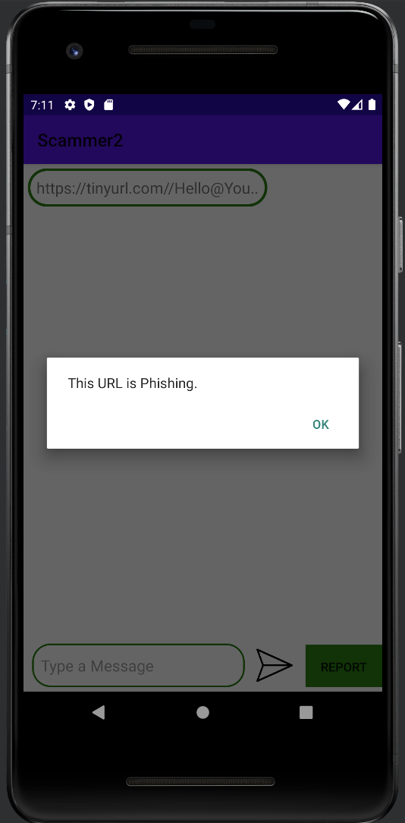
Phishing Classification

Slide 9
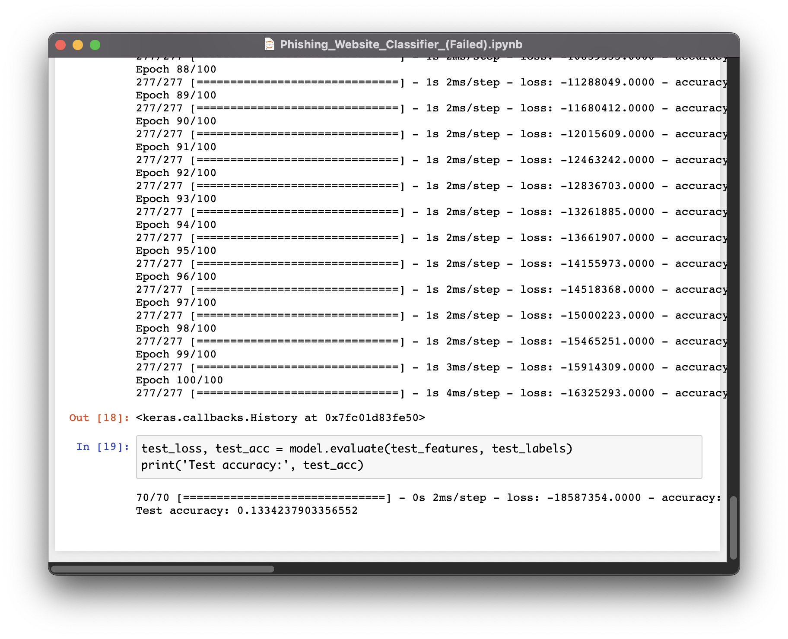
Approach – Rule Based Classification
Based on a research paper
by Rami M. Mohammed et al.

Slide 10
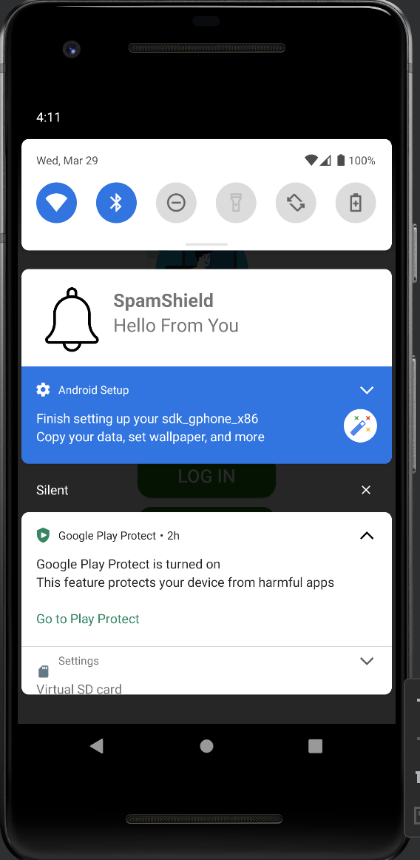
Notification Classifier

Slide 11
Why Notification Classifier?
WHY? : For old people, we need to have seamless integration over all the apps, because they are not so tech savvy and hence they need easy solutions

Slide 12
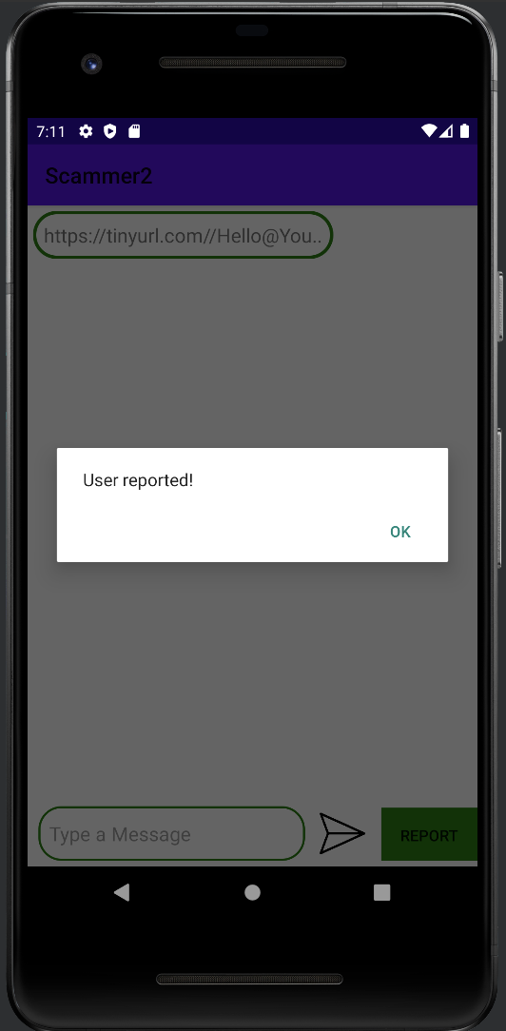
Report the user

Slide 13
Why report feature?
WHY? : Spammers are constantly evolving. We need to evolve with them to keep up the demand
SOLVES : Increase in Cybercrime incident

Slide 14
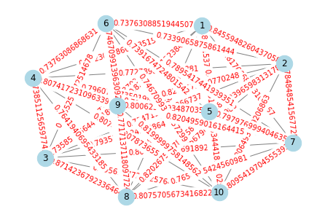
Graph based Inference

Slide 15
Why this method?
WHY? : For the police to find patterns in malicious senders so that they can be more efficient in nabbing the criminals
SOLVES : Difficulty in Tracing the Criminals

Slide 16
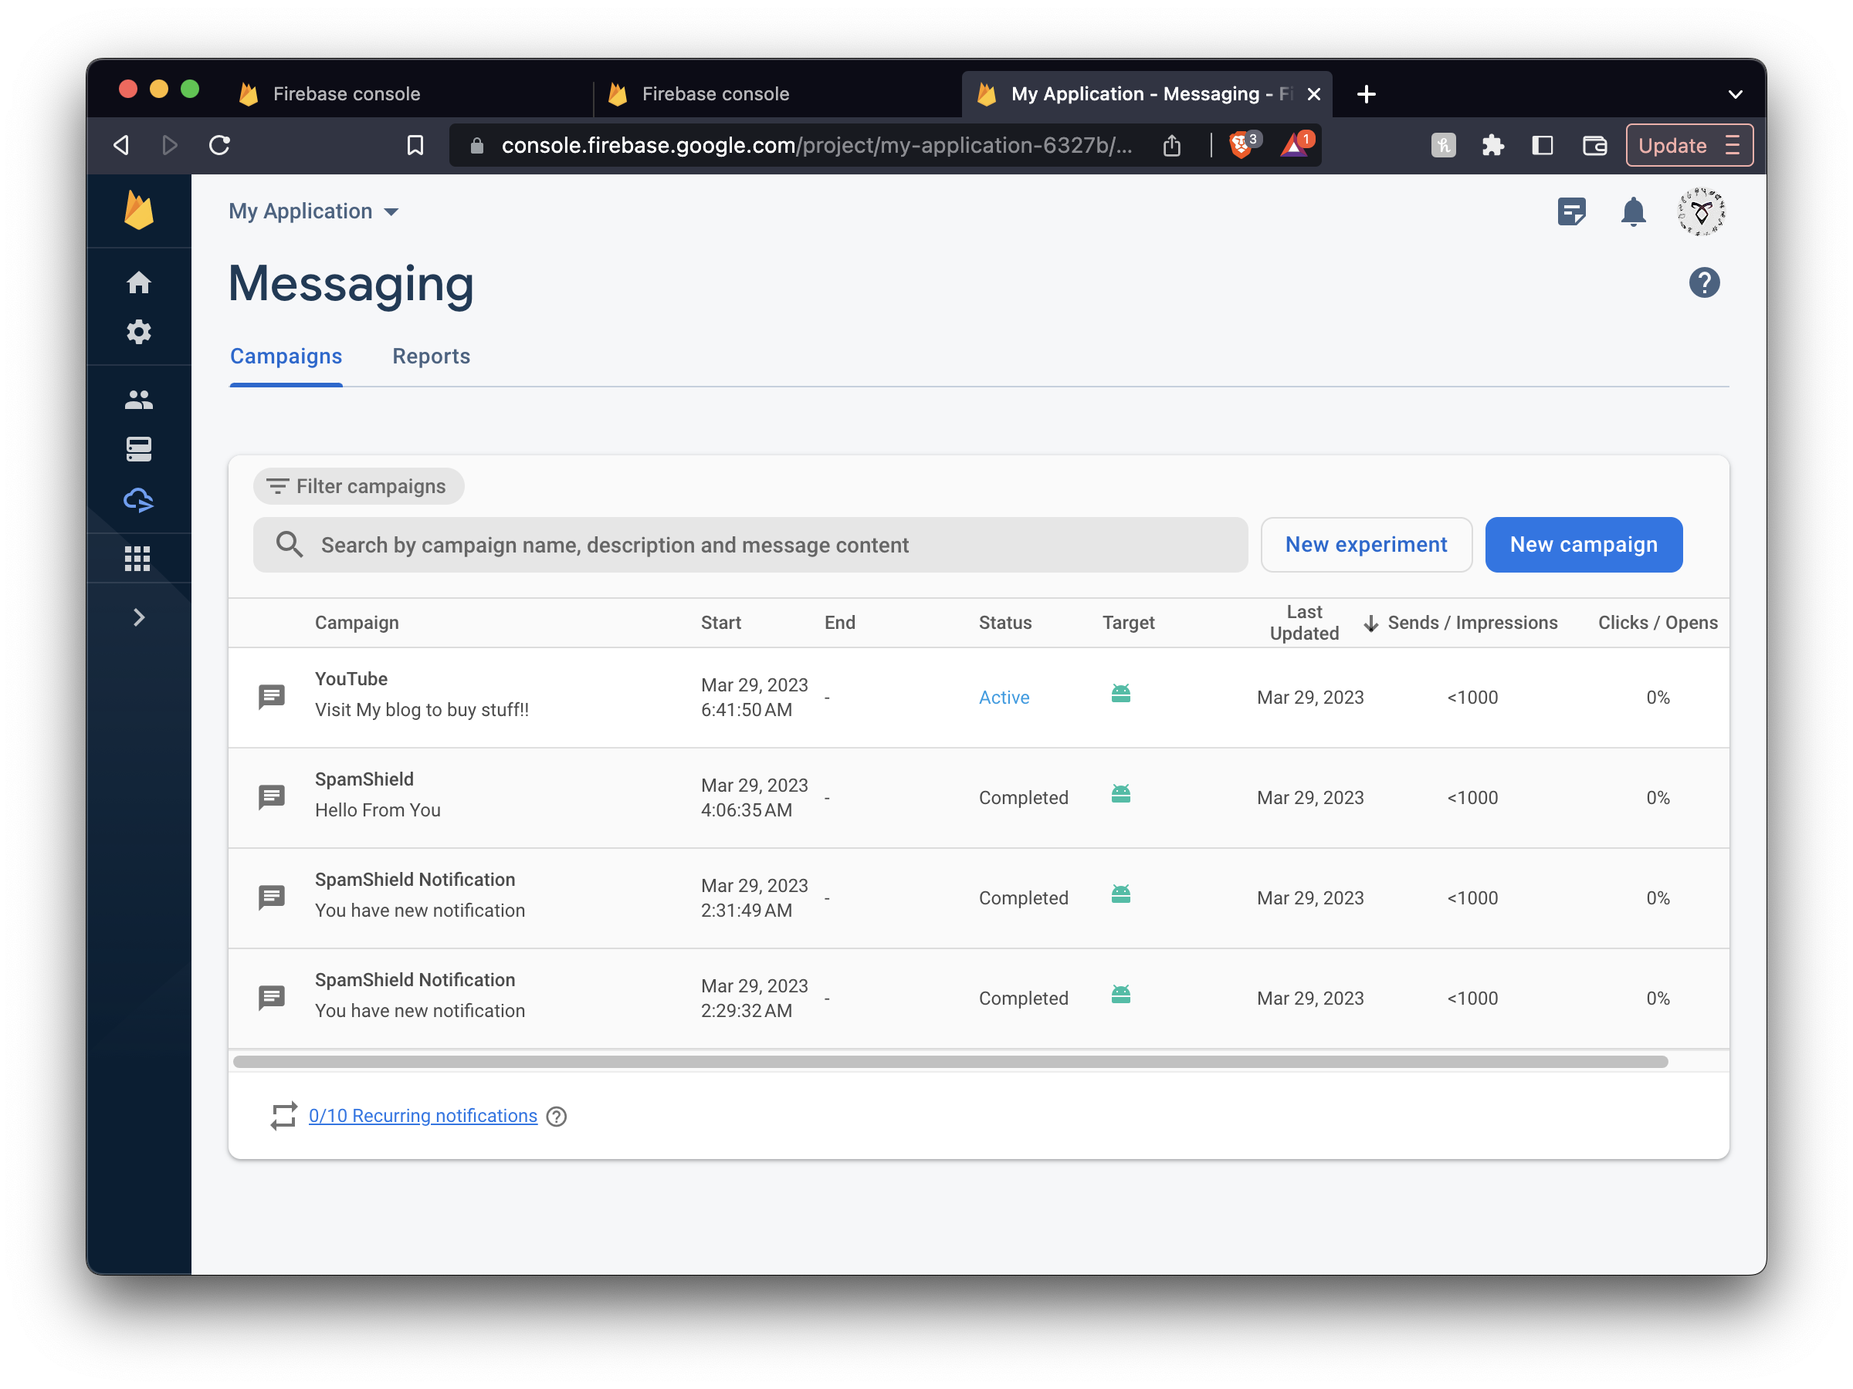
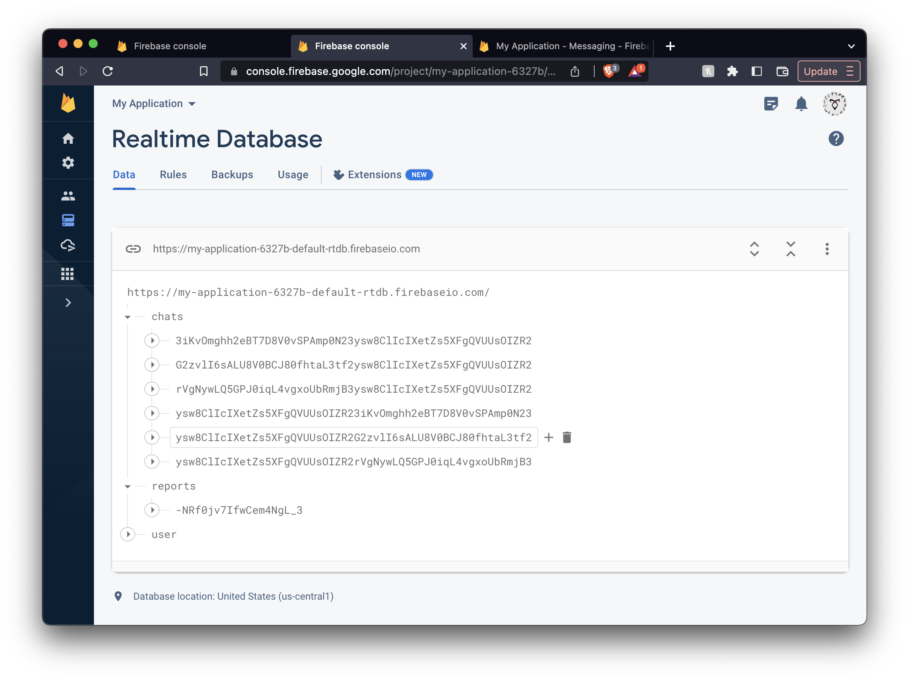
Server - Backend

Slide 17
Proposed Architecture
Our project will use a client-server architecture, with the Android app acting as the client and a server-side application handling the graph database analysis. We chose this architecture because it allows for scalability, security, and ease of maintenance. The server-side application will be responsible for handling the graph database, which will analyze the patterns in incoming messages. However, the actual spam detection model will be local, so that we can detect spam and warn users without the need for an internet connection.

Slide 18
Innovations Incorporated
Two major innovations have been incorporated into this application :
The ability to use the application as a primary messaging app or as a secondary messaging app gives users the option and flexibility to choose whether they want to use our app or a different application while also ensuring that they will be protected against spam messages
Rule based Phishing Classifier inbuilt
Reporting System
By using a graph backend database and finding out connections between senders, it is possible for the police to track down and nab the criminals in a much more easier and efficient pattern

Slide 19
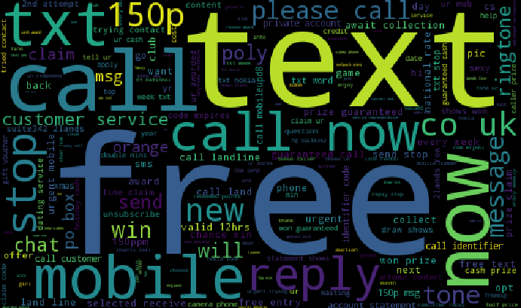

Slide 20
Feasibility of Solution
The spam detection app solution is a feasible and innovative approach to detecting spam messages. The use of a graph database at the backend to analyze patterns in malicious messages using collaborative filtering is an efficient way to detect spam messages quickly and accurately. In fact, many websites with heavy traffic like Twitter also use graph databases in the Backend. By using a service like Firebase or AWS, we can ensure the scalability of our application and also ensure that we get the data at a low latency. We can also use the same model and approach for different scenarios, making it an ideal starting point for new innovations. Also, since we are using common design practices, It will make it easier for others to understand and develop their features on top of our application.

Slide 21
Future scope
Automated Spam Phone Call Tracking
Encryption Detection: Develop a technique that can detect and flag messages that are encrypted

Slide 22
Conclusion
In conclusion, our spam detection app provides a comprehensive and innovative solution to the problem of identifying and filtering spam messages on Android devices. By using a client-server architecture with a graph database analysis and local machine learning model for classification, we can provide fast, accurate and reliable spam detection even in areas with limited internet connectivity. Our solution can help users to stay safe from malicious messages and reduce the risk of falling victim to scams or cyberattacks. We are confident that our app will provide real value to users, and we look forward to the opportunity to bring this innovative solution to market. Thank you for considering our project, and we appreciate your time and attention.

Slide 23
Thank You!

